Slide 1
Presentation On Predicting Electricity Consumption using Deep Recurrent Neural Networks
Presented By:
Gaikwad Sanket Navnath Roll No : 315
Pise Suhas Hari Roll No : 358
Shubham Jagdish Zargad Roll No : 373
Kulthe Krushna Haribhau Roll No : 345
Guided By
Prof. S.S. Nimbalkar
Department of computer Engineering

Slide 2
Introduction
The rapid increase in electricity consumption requires an accurate forecasting of electricity consumption distribution. In order to accurately forecast the electricity usage, the electricity consumption needed to be tracked. Therefore, Advanced Metering Infrastructure (AMI), was introduced. AMI leads to a large amount of electricity consumption data. AMI data is used for electricity consumption forecasting. Forecasting helps make decisions on power distribution from the national grid. An accurate forecast on the electricity consumption can prevent unplanned electricity distribution disruptions AMI provides the background to utilize data for descriptive, predictive and prescriptive analytics The demand for energy is based on various factors such as weather, occupancy, types of machines and appliances used. The dependency on high number of factors have made forecasting techniques much complex. Accurate predictions of the electricity consumption is important for efficient distribution. However, applying all the variables that effect electricity consumption can create a complex forecasting model which is unstable and unpredictable Therefore, data-driven solutions to predict electricity consumption focuses on time-series solutions

Slide 3
Electricity consumption is a time-dependent attribute. Therefore, there are approaches that use time series to build the model to predict electricity consumption. Availability of past information leads to solutions based on time series analysis since it reflects the time-dependent variations. The forecasts for electricity consumption have been identified as short term (hourly to one week), mid-term (one week to one year), and long term (more than one year) forecasts. Time-series analysis techniques are addressed using conventional approaches and AI-based approaches (ANN, ARIMA, SVM, Fuzzy based techniques). Past research shows these techniques perform better for short term forecasting but poor in mid-term and long term forecasting. The research conducted on mid-term to long term forecasting shows an excess of 40%-50% in relative errors. There are many challenges for mid-term and long term electricity consumption forecasting, and thus form the focus of this paper. This paper presents two approaches, a RNN and a LSTM, to forecast electricity consumption for short-term, mid-term and long-term. The RNN and the LSTM were used to predict daily, trimester and thirteen monthly electricity consumption. The RNN and the LSTM are compared with the most common and popular electricity consumption prediction models (ARIMA, ANN and DNN). Both models have shown to minimize the root mean square error compared to the other models. The models were tested on the publicly available London Smart Meter dataset. The experiments were conducted on predicting both an individual houses electricity consumption and a block of houses electricity consumption. The LSTM and RNN have achieved, on average a Root Mean Square Error (RMSE) of 0.1 for all cases.

Slide 4
Methodology
Deep learning is capable of learning from hidden patterns with no feature selection and outperform most of the machine learning and statistical methods to achieve various tasks. Time series data holds a sequential pattern, in which the data holds co-relationships between parallel data instances (𝑥𝑡 depends on 𝑥𝑡−1 and 𝑥𝑡 effects 𝑥𝑡+1 ). Sequential data is handled by Recurrent Neural Networks (RNN), Long Short-Term Memory Networks (LSTM) and memory networks due to the capability of memory to hold past information.

Slide 5
Data pre-processing
In order to predict an individual houses, electricity consumption data is not preprocessed because it is important to focus on models that relies less on preprocessing. The data for an individual house is separated from the blocks’ electricity consumption. In order to predict a blocks electricity consumption, the data had to be pre-processed as follows. A block electricity consumption is predicted using all the houses electricity consumption per day and the mean of the electricity consumption per day.
The time periods of each house is not consistent throughout a given block. Therefore, a common time period which most of the houses are involved in a given block is taken for block predictions. The mean electricity consumption for a given day is calculated

Slide 6
for the above selected time interval allowing a larger set of houses to calculate the mean value. An example mean value calculated for the block 36 is given2 . The mean value would generate one value to a given date for the block. Predictions were performed using RNN and LSTM the most common deep time series, prediction models.

Slide 7
Setting up training and testing data
The dataset is divided into training and testing data. The testing data is kept separate from the training data. Therefore, the testing data is unseen to the model until testing the models. The models were trained on 80% of all data and tested on 20% of all the data. The training and testing data is divided into three different methods. In order to understand the electricity consumption of an individual house and a block of houses, the training data is set up.
Given one day predicting the next day This is done for the blocks of houses and individual houses. The model will be trained to take one day’s input and predict the next day’s electricity consumption.
Given one month and predicting the next month. In order to get a balanced dataset, only 600 days are considered. This method is applied to individual houses and blocks mean value predictions.
Given three months and predicting the next three months. Balance dataset is achieved by using 600 days. Three months were given to predict three months ahead.
However, in order to show that the models are capable of learning from a short term, mid-term and long term, the data is divided. The short term predictions are shown by predicting one day ahead, the mid-term prediction is shown by predicting 3 months ahead, and the long term is shown by predicting 13 months ahead. The input 𝑥𝑡 is used to predict the output (𝑥𝑡+1 ). 𝑥𝑡 can be one day’s, three months and 13 months electricity consumption for an individual house or block of houses.

Slide 8
LSTM
The LSTM has a complex architecture compared with the RNN. which includes three gates that are used to filter and carry forward the past data . The input 𝑥_{𝑡} is passed and added to the ℎ_{𝑡−1}. The 𝑓_{𝑡} gate decides if 𝐶_{𝑡−1} is carried forward to generate the current output (ℎ_{𝑡}). Unlike the RNN which carries on 𝑦_{𝑡−1}, the LSTM decides on which data is carried forward through the cell state (𝐶_{𝑡−1}). Furthermore, unlike RNN, the LSTM cell contains the input gate and the output gate to create the final output. 𝐶 carries the ℎ_{𝑡−1} to the next time stamp. However, unlike RNN the LSTM calculates the 𝐶. LSTM therefore, has a controlled over the 𝐶 and the ℎ_{𝑡} rather than directly generating the output. LSTM cell is considered as a unit, and the unit can be sequentially connected to each other. The LSTM has 100 LSTM units and the last layer has one dense layer before generating the final output. The LSTM used in the experiment ran for 300 epochs to train to the optimal results. The Adam optimizer was used to generate the highest accurate results. 20 batch size was used for the LSTM.
shows how the LSTM structure applied in the experiment.

Slide 9
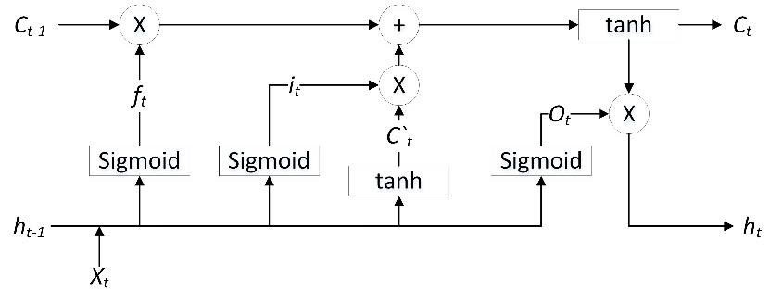
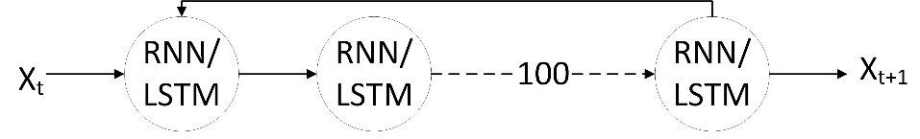
Long Short Term Memory Network (LSTM) cell architecture
Is the structure of the LSTM or RNN. The model has 100 hidden layers. The model takes input and predicts batch. 𝑥_{𝑡} and 𝑥_{𝑡+1} can be a day, month or 3 month

Slide 10
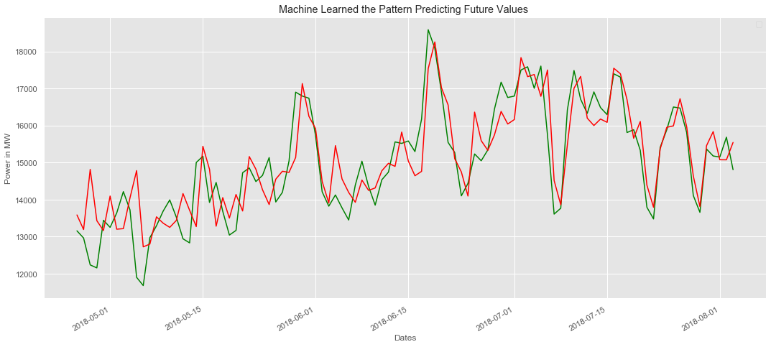
Results
The below graph shows the actual value and predicted values of electricity bill
Where green line show actual value and red line shows the value which are predicted by the model.

Slide 11
Conclusion
In conclusion, we have built a relatively accurate neural network model to predict energy consumption
LSTM is capable of predicting short term, mid-term and long term forecasts for electricity consumption with high accuracy

Slide 12
References
Rahman, A., Srikumar, V., Smith, A.D.: Predicting electricity consumption for commercial and residential buildings using deep recurrent neural networks. Applied energy. 212, 372-385 (2018).
Wang, Y., Chen, Q., Hong, T., Kang, C.: Review of smart meter data analytics: Applications, methodologies, and challenges. IEEE Transactions on Smart Grid. (2018).

